Slide 1

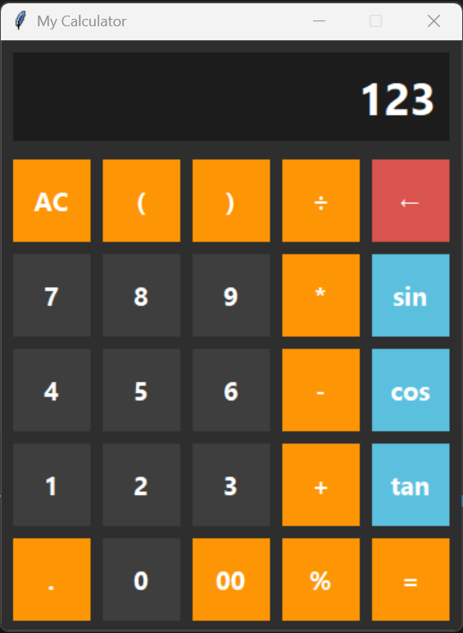
Next Hikes IT Solutions
Python Calculator with GUI
The goal of this project is to create a functional and user-friendly calculator using Python’s Tkinter library for the graphical user interface (GUI), and Handle mathematical expressions and operation efficiently.
Abdus Samad

Slide 2
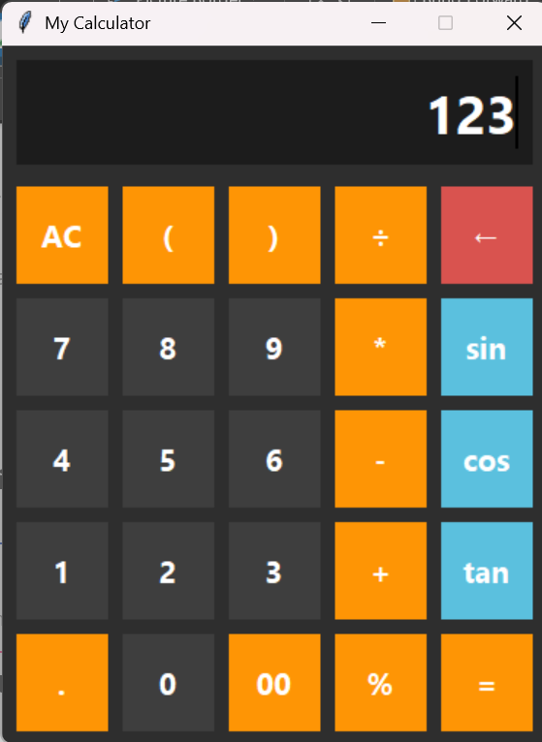
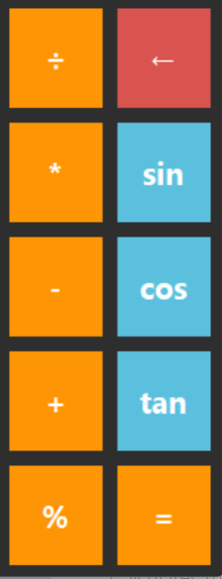
Functions Used In The Project
This calculator performs basic operations like addition, subtraction, multiplication, division along with scientific functions such as sin, cos and tan.
Addition(+)
For adding two numbers.
Sine(Sin)
Subtraction(-)
Calculates the sine of an angle (in radians).
For subtraction one number from another.
Cosine(Cos)
Calculates the cosine of an angle (in radians).
Multiplication(*)
For multiplying two numbers.
Tangent(tan)
Division(/)
Calculates the tangent of an angle (in radians).
For dividing one number by another.

Slide 3


Tools & Technologies Used
This project was developed using Python and Visual Studio Code, with core Python concepts and Tkinter for building the GUI.
Software
Technologies
VS Code
Python
Core Python
Tkinter Library
GitHub

Slide 4

Demo Screenshot:
Display Area
All Clear Button
Trigonometric Button
Representing Number Button
Core Mathematical Button

Slide 5
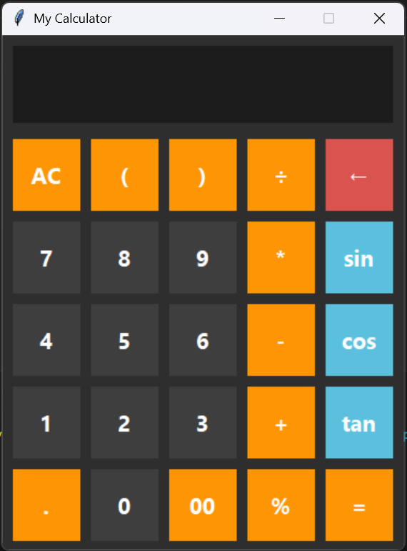
Challenges Faced & Solution Implemented
While building the GUI Calculator, challenges like arranging the layout, managing inputs, preventing calculation errors, and implementing both basic and scientific operations were encountered. Each challenge was addressed with appropriate coding techniques and solutions.
Aligning GUI Components Solution: Used Tkinter's grid() function to properly align buttons in rows and columns, and set padding and width for better spacing.
Event-Driven Programming Solution: Used the bind() function to handle button clicks and manage button actions through the getvals() function.
Ensuring Accurate Calculations Solution: Used the eval() function for calculations and handled errors like divide by zero using a try-except block.
Managing User Input Solution: Provided an AC button to clear input and a BackSpace() function to remove the last entered character.
Complex Layout Handling Solution: Organized the layout by dividing buttons into different frames for better functionality and easy navigation.
Handling Math Operations Safely
Solution: Ensuring the proper handling of mathematical expressions (like division by zero, invalid characters, etc.).

Slide 6
References or Resources
The following references and resources were used for documentation, libraries, and development support during the project.
Python Documentation & Download.
Rresearch
https://docs.python.org/3/
https://www.python.org/downloads/release/python-3132/
Tkinter Library for GUI
https://docs.python.org/3/library/tkinter.html
https://www.geeksforgeeks.org/python/python-simple-gui-calculator-using-tkinter/
Visual Studio Code
https://code.visualstudio.com/docs

Slide 7
Conclusion
“Through this project, I developed a functional calculator that leverages core Python and Tkinter skills, meeting the project requirements effectively.”

Slide 8
Thanks

